Slide 1
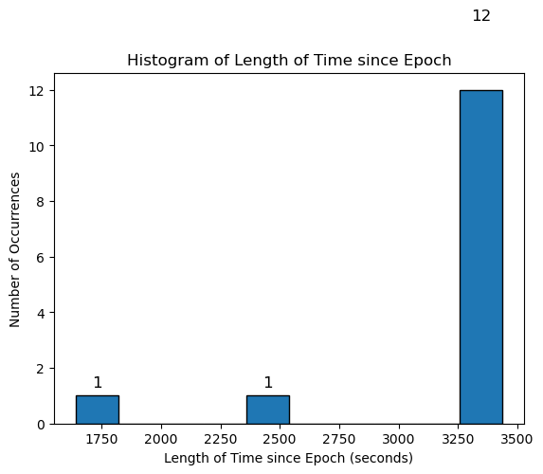
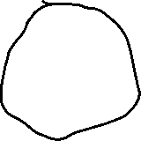

From my laptop I run 14 files,
The 20240612_190135 is including bad data that elevation angular is negative.
The 20250131_010134 is the data that have less data point.
20250131_010134_scanAz_slow.txt
20240612_190135_scanAz_slow.txt

Slide 2
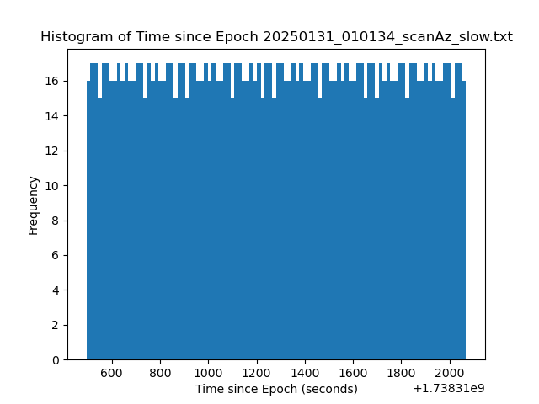

Slide 3
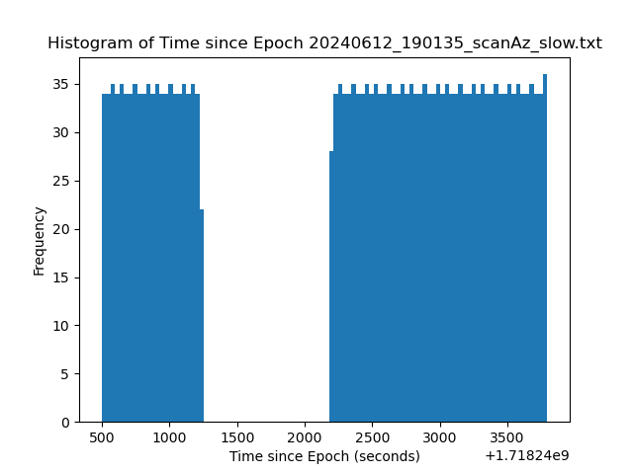

Slide 4
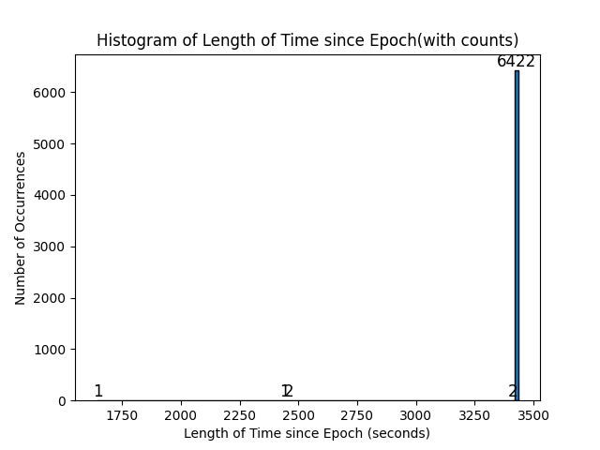
The histogram for one year

Slide 5
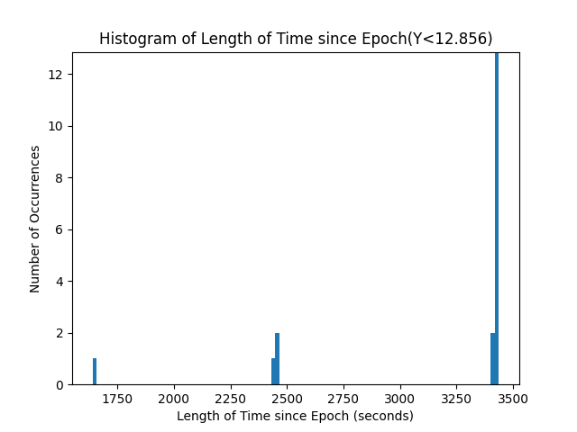

The two files little less normal value are confused.
I think I need check what are them

Slide 6
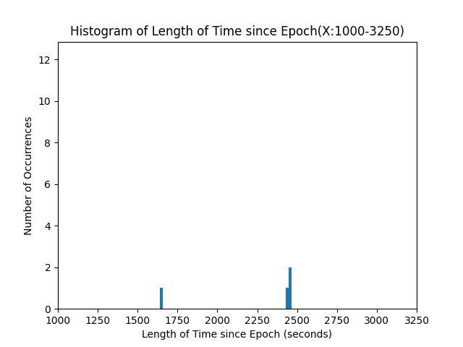
For over one year’s data,
I find we have 1 less 1750, which should be 20250131_010134 files

Slide 7
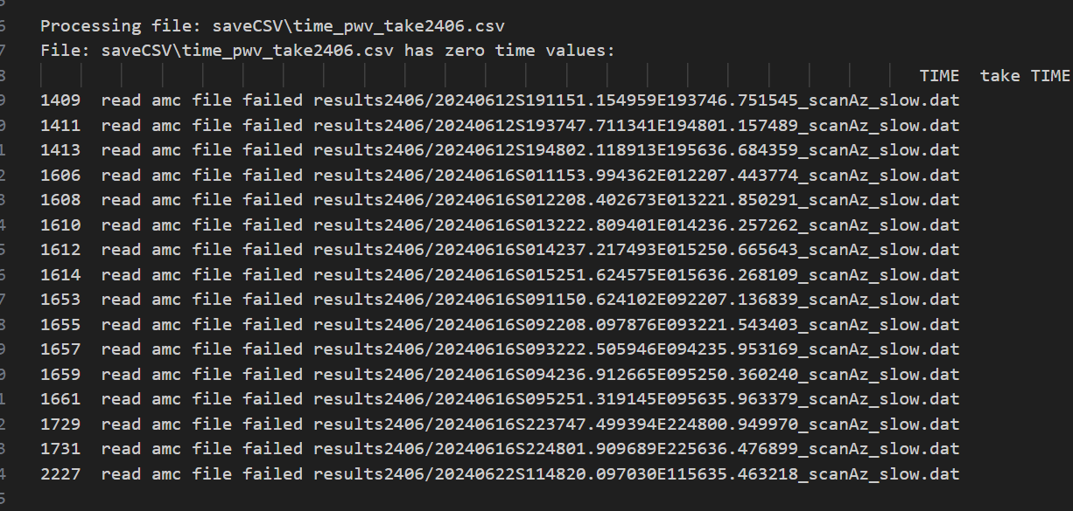
This is the time record csv that record skip .dat file show the three files between 2250-2500 are 20240612 20240616 and 20240622.

